Slide 1

“ Every Challenge is a New Opportunity : We Like Challenges “

Slide 2




Our Service Offering
An End to End Recruitment Services Company.
Specialised in exhaustive screening and headhunting
An android app to help companies find candidates locally
Helps companies in increasing the conversions for events like walk-in interviews, Tech Talks, Hackathons, Meetups, etc
An Hackathon platform to chase the right talent than copy pasted CV
Hosted 6 hackathons including 2 successful all women hackathons
Platform for constant learning in meetup.com
Sharing the trending topics to aspirants
Building the actual database of talents

Slide 3
Pricing
djobs | DexterHack | Bangalore Tech Talk | Dexter Talent Labs
Rs.500/- per week per posting | Rs.60k for 8 hours | Rs.5k per half day event | 8.33% - 0 to 5 yrs 10% - 5.1 to 10 yrs 12% - 10+ yrs
Above all excluding the taxes as applicable Hackathon charges are excluding Venue, Prizes, Food & Beverages Tech Talk event is excluding Venue, beverages.

Slide 4













Few Clients

Slide 5
Case Study – Xhacknight
Approach
Jointly hosted Hackathon along with Microsoft & Xhackers specifically to identify and groom tech talents in Xamarin Platform
Challenge
Design an application in iOS or Android.
Target Community
Crowd sourcing campaign for a period of 4 weeks to attract highly skilled Xamarin, C#, .Net, iOS & Android developers
Outcome
Successfully hired 3 developers for two of our existing clients

Slide 6
Case Study – What kind of hacker are you?
Approach
One day Coding Contest– 8 am to 8 pm at Thoughtworks, Bangalore
Challenge
Design an application in iOS or Android.
Target Community
Crowd sourcing campaign for a period of 4 weeks to attract highly Android, iOS, Windows Mobile & Web developers
Outcome
Successfully placed 4 developer.

Slide 7
Case Study – Use your Hacking Skills to Increase Women’s Safety
Approach
One day Coding contest– 8 am to 8 pm
Challenge
All Women Hackathon. Women to come forward and code to increase Safety of Women using technology
Target Community
Campaigns for a period of 4 weeks to attract highly skills / passionate Women coders in technologies like Android, iOS, Windows Mobile & Web developers
Outcome
Women participation in any Hackathon is 5 to 6. However we were able to have 150+ registrations & 60+ turned out and hacked whole day to come out with awesome technological solutions to increase Women’s safety which the NGO is already started implementing.

Slide 8
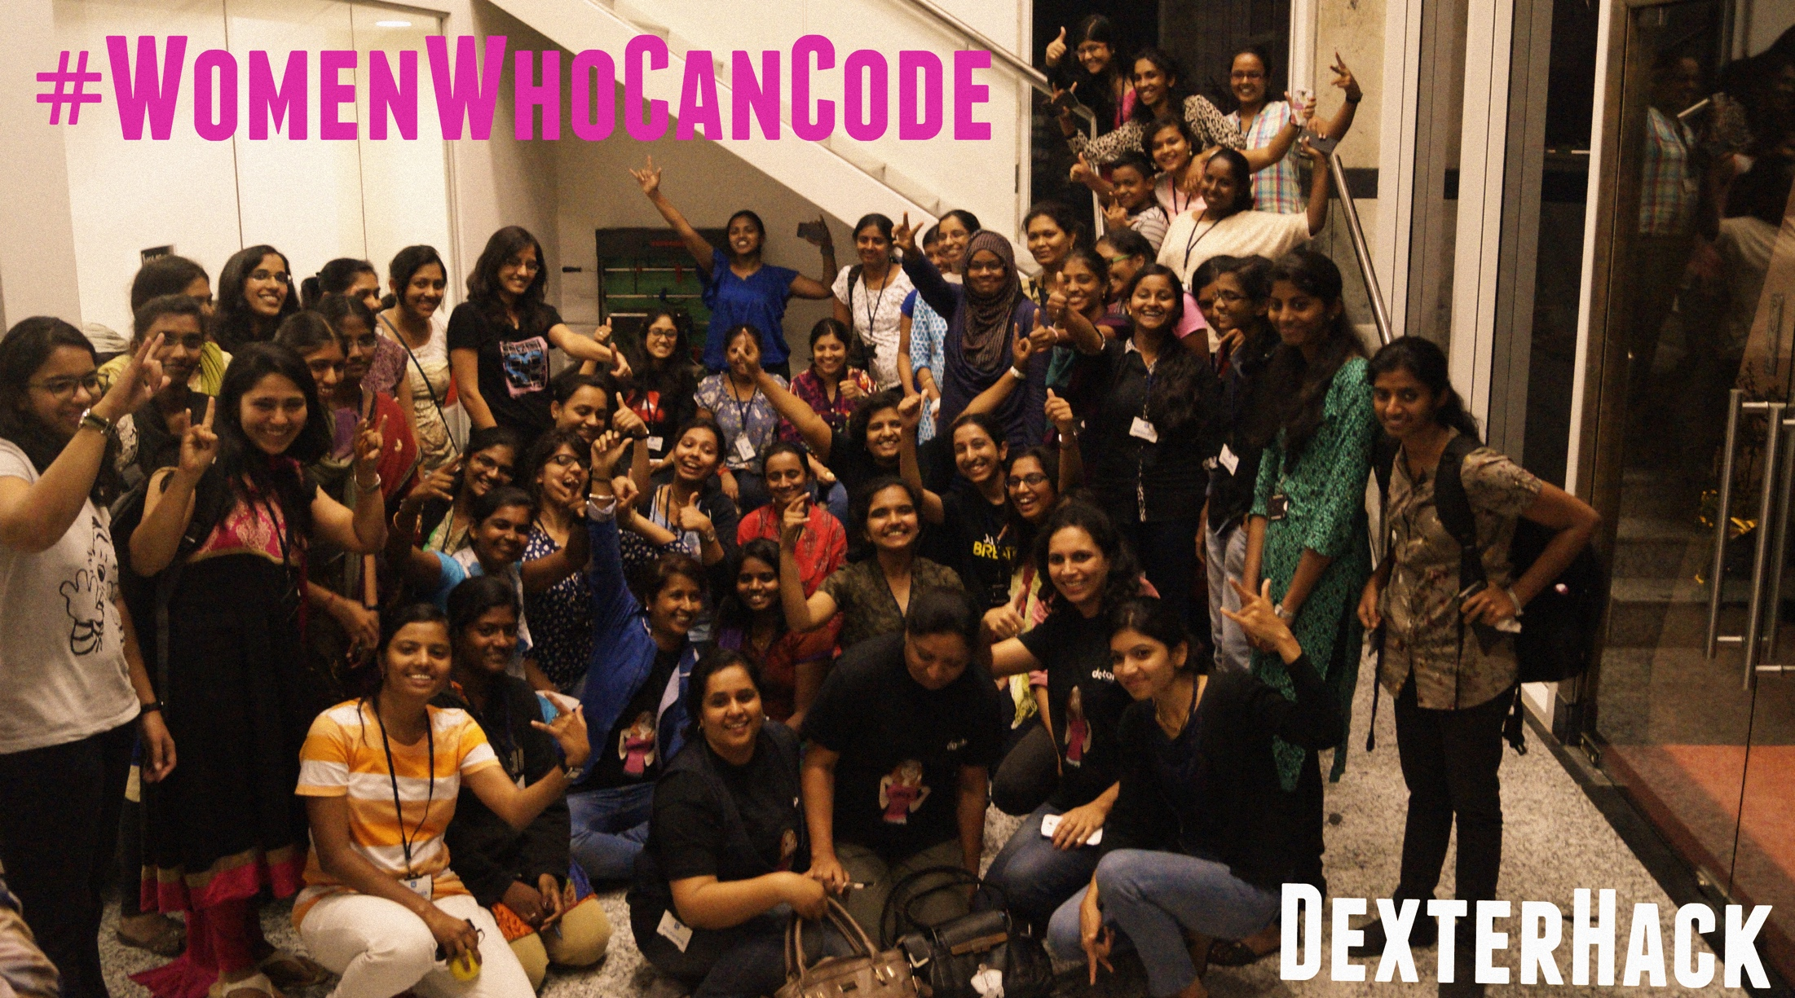

Slide 9
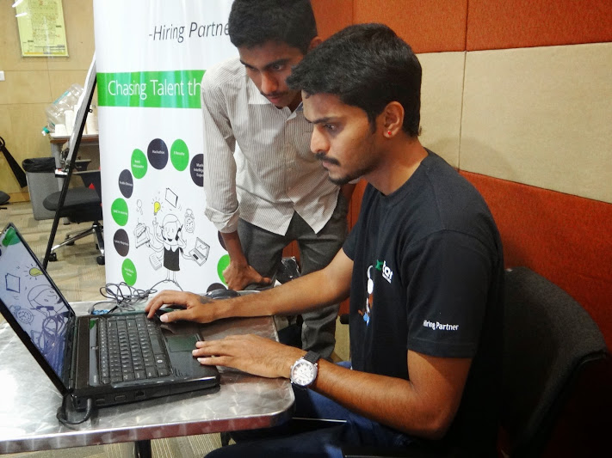
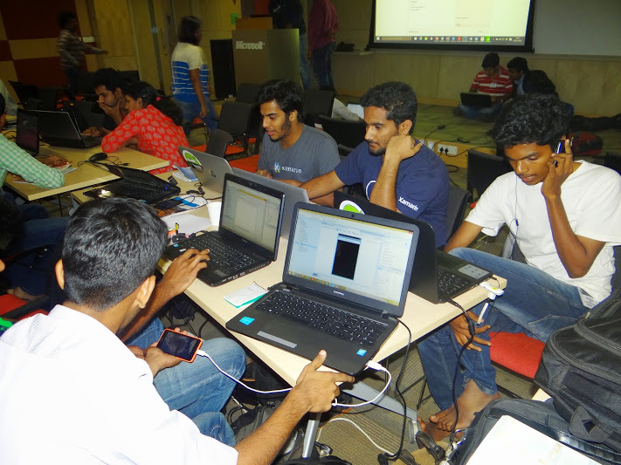
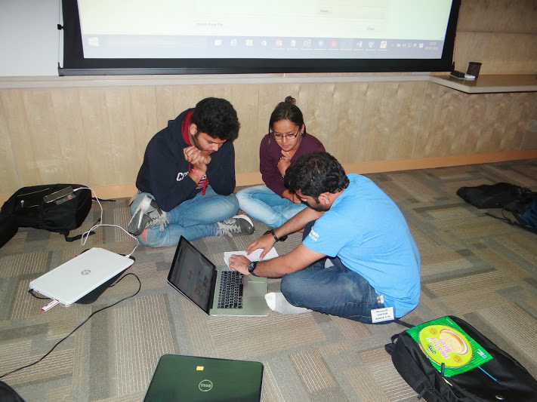
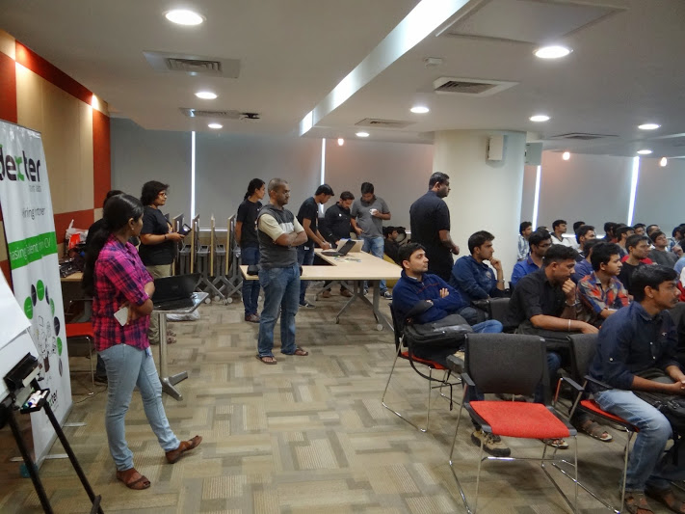
E-mail campaign

Slide 10
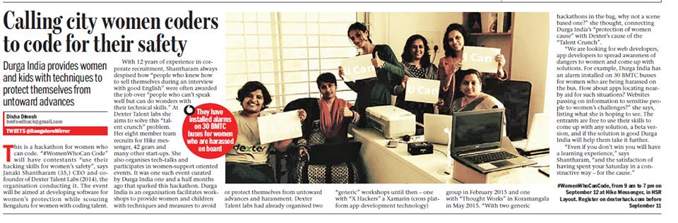
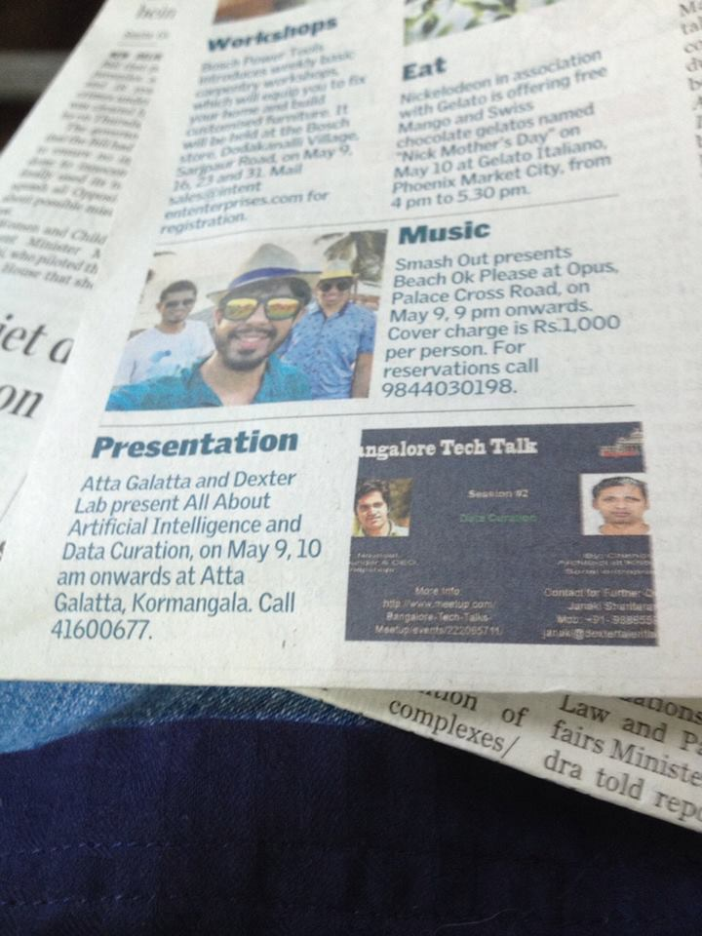
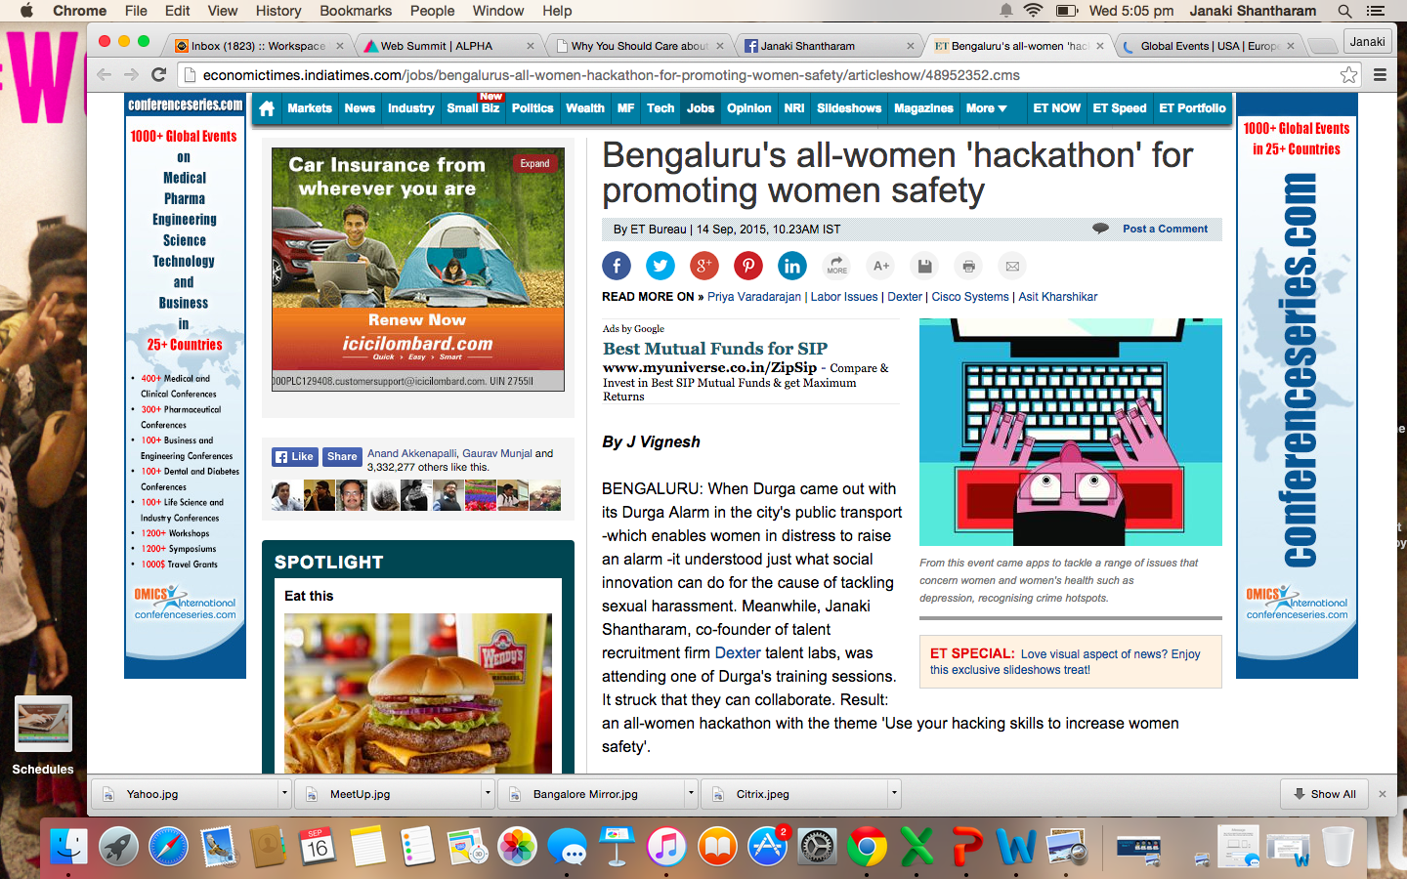
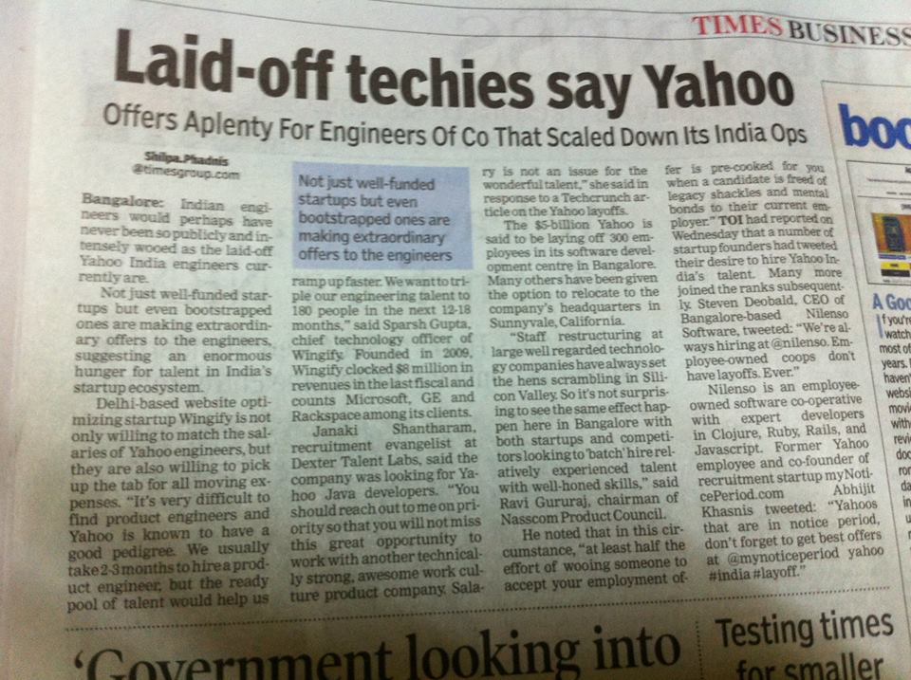

Slide 11



Here we are
 | 9886559155
 | janaki@dextertalentlabs.com
 | www.dextertalentlabs.com

Slide 12
